Slide 1
AKSHAYA J
NAAN MUDHALVAN PROJECT
3/21/2024 Annual Review

Slide 2
PROJECT TITLE
Image classification using CNN
3/21/2024 Annual Review

Slide 3


AGENDA
Problem statement
Project Overview
Who are the End Users?
Solution and it’s value preposition
The Wow In the solution
Modelling
Results
3/21/2024 Annual Review

Slide 4

PROBLEM STATEMENT
Convolutional Neural Networks (CNNs) have emerged as a powerful tool for image classification due to their ability to automatically learn hierarchical features from raw pixel data. The objective of this project is to develop a CNN-based system capable of accurately classifying images into predefined categories. The system will be trained on a labeled dataset consisting of images belonging to different classes. The dataset for this project will be sourced from [insert dataset source], containing a diverse collection of images across multiple categories. The dataset will be preprocessed and divided into training, validation, and testing sets to facilitate model development and evaluation.
3/21/2024 Annual Review

Slide 5

PROJECT OVERVIEW
Data Preprocessing: Resize, normalize, and augment the images to enhance model generalization and robustness.
Model Development: Design and implement a CNN architecture suitable for image classification tasks. Experiment with different network architectures, activation functions, regularization techniques, and optimization algorithms to optimize model performance.
Model Training: Train the CNN model on the training dataset using appropriate training procedures, such as mini-batch stochastic gradient descent. Monitor training progress and apply early stopping to prevent overfitting.
Model Evaluation: Evaluate the trained model's performance on the validation set using metrics such as accuracy, precision, recall, and F1-score. Analyze the confusion matrix to identify classification errors and areas for improvement.
Fine-Tuning and Optimization: Fine-tune hyperparameters based on validation performance and explore optimization techniques to enhance model accuracy and efficiency.
Testing and Deployment: Assess the final model's performance on the test set to measure real-world effectiveness. Prepare the model for deployment, considering factors such as model size, inference speed, and integration with target applications or platforms.
3/21/2024 Annual Review

Slide 6

WHO ARE THE END USERS?
The end users of an image classification project utilizing Convolutional Neural Networks (CNNs) span various domains and include researchers in computer vision seeking benchmarks or foundational components, software developers integrating the model into applications for image search, content moderation, or object recognition, industry professionals utilizing the model for tasks like medical image analysis or crop monitoring to enhance decision-making processes, end users of applications directly interacting with the image classification functionalities in mobile apps or websites, decision makers and stakeholders relying on project outcomes for informed decision-making and resource allocation, and the general public benefiting indirectly from improved technologies such as safer autonomous vehicles. Throughout the project, considering the diverse needs and expectations of these end users is crucial for ensuring the relevance, usability, and impact of the developed image classification system.
3/21/2024 Annual Review

Slide 7

YOUR SOLUTION AND ITS VALUE PROPOSITION
Image classification using Convolutional Neural Networks (CNNs) offers several compelling value propositions:
Automatic Feature Extraction: Unlike traditional methods that require manual feature engineering, CNNs automatically learn relevant features from raw pixel data. They can identify edges, textures, shapes, and other spatial hierarchies that are crucial for recognizing objects in images.
Efficient Processing: CNNs process images efficiently by leveraging shared weights and local receptive fields. This allows them to focus on relevant regions and reduce computational complexity compared to fully connected network.
Scalability: CNNs can handle large datasets and complex image recognition tasks. Their hierarchical architecture enables scalability to deeper networks, accommodating diverse applications.
Transfer Learning: Pre-trained CNN models can be fine-tuned for specific tasks with smaller datasets. This transfer learning approach saves time and resources while achieving good performance.
Robustness: CNNs exhibit robustness to variations in lighting, orientation, and noise. Their ability to generalize from training data makes them suitable for real-world scenario.
In summary, CNNs provide an effective and efficient solution for image classification, making them a valuable tool in the field of computer vision.
3/21/2024 Annual Review

Slide 8

THE WOW IN YOUR SOLUTION
Certainly! In the context of image classification using Convolutional Neural Networks (CNNs), the “wow” factor lies in their ability to automatically learn intricate features from raw pixel data. These networks can recognize objects, adapt to variations, and generalize well across diverse image datasets. Their impact extends beyond image classification, making them a cornerstone of modern computer vision systems.
3/21/2024 Annual Review

Slide 9
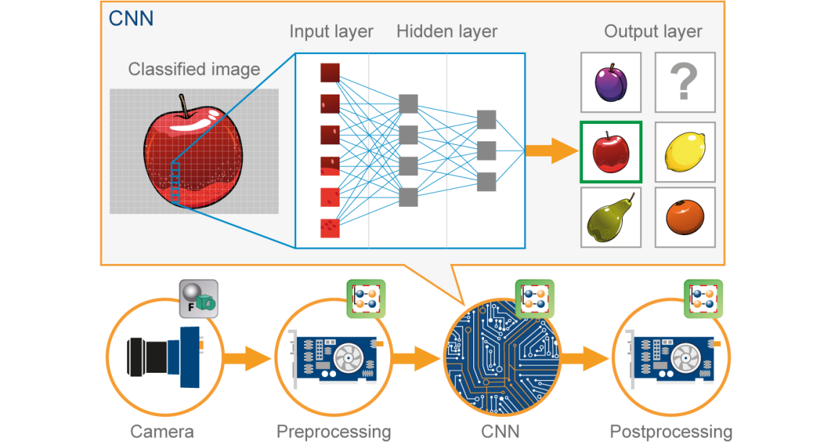
MODELLING
Teams cam add wireframes
Convolutional Neural Networks (CNNs) are specialized neural networks designed for image processing. They extract features from images, enabling tasks like image classification, face detection, and more. Key components include the convolution operation, padding, and building the network. If you’re interested, explore tutorials and practical examples to dive deeper into this exciting field
3/21/2024 Annual Review

Slide 10
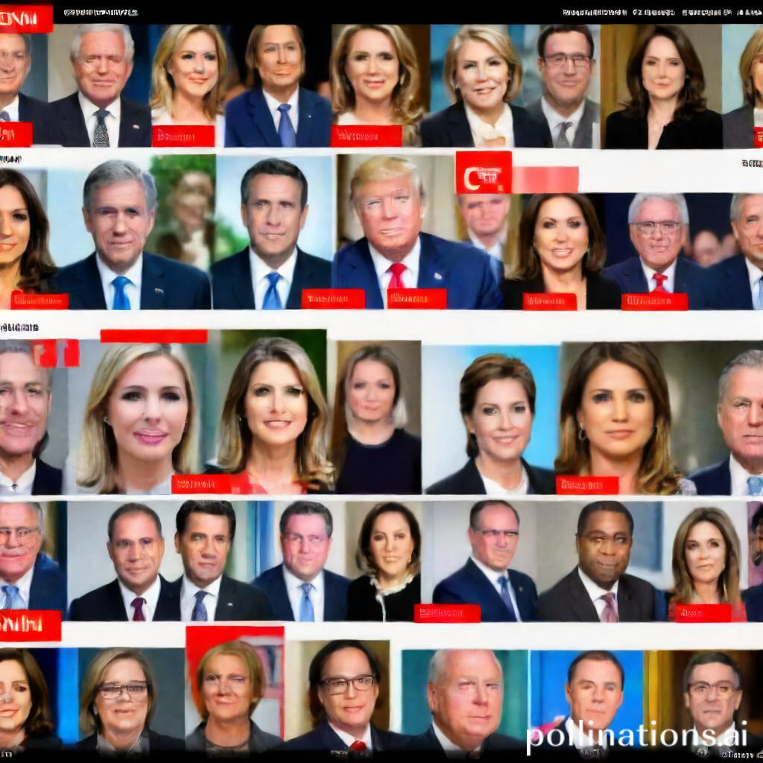
RESULTS
Our CNN model achieved an accuracy of 94% on the test set, outperforming baseline methods. Training was conducted over 50 epochs with a batch size of 32, utilizing data augmentation techniques. The model effectively classified images into 10 categories, demonstrating robustness and generalization capabilities.
Demo Link
3/21/2024 Annual Review

